Slide 1

.
New ways of making an impact locally
Noelette Hanley
Chief Officer
Luton Irish Forum

Slide 2
Overview
Introduction to LIF;
Development of LIF’s reputation as a provider of health and wellbeing services in Luton;
The Healthwatch application process;
The work involved in the delivery of the Healthwatch contract.

Slide 3
Luton Irish Forum
Registered Charity & Company Limited by Guarantee;
Formed in 1997;
9 staff & 100 volunteers;
900 members;
Serves Luton and the surrounding areas;
Provides welfare support relating to welfare benefits, housing, debt and provides practical support to engage with Ombudsman services, tribunals, courts and appeals;
Coordinates a range of activities, groups and events which raise cultural awareness; promote health and wellbeing; improve quality of life; and foster better inter-community networking and co-operation through pioneering multicultural initiatives and school based workshops;
Promotes health and wellbeing and community learning through talks; health MOT days; keep fit, yoga, dance, language, literary and art classes and computer clubs;
Facilitates social opportunities through our luncheon clubs and has a 16-seat minibus that enables users with mobility difficulties to attend;
Heathwatch activities.

Slide 4
Development of Reputation
Raising awareness of community needs;
Redevelopment of premises;
Presence on key fora;
Development of partnerships;
Development of profile as a community champion;
Focus on quality;
Focus on sustainability.

Slide 5
‘Healthwatch’ contract
Competitive tendering process;
Stage 1: A review of key information
To ensure that we are properly constituted, viable and have appropriate provision for insurance, business continuity, quality assurance, health and safety and equal opportunities;
Stage 2: Price and Quality Assessment
Price - a maximum of 20% of the overall score;
Any Tenderer submitting a bid sum above the maximum price was rejected;
Quality Assessment – Written Submission: 60% of the overall score;
Maximum word count of 500-2000 for Method Statements each scoring 1-5 points;
Quality Assessment - Interview: 20% of the overall score based on Method Statements;
Shortlist up to four Tenderers for interview - to clarify the information submitted in the Written Submission;
Right to adjust the Written Submission scores;
References for all shortlisted Tenderers.

Slide 6
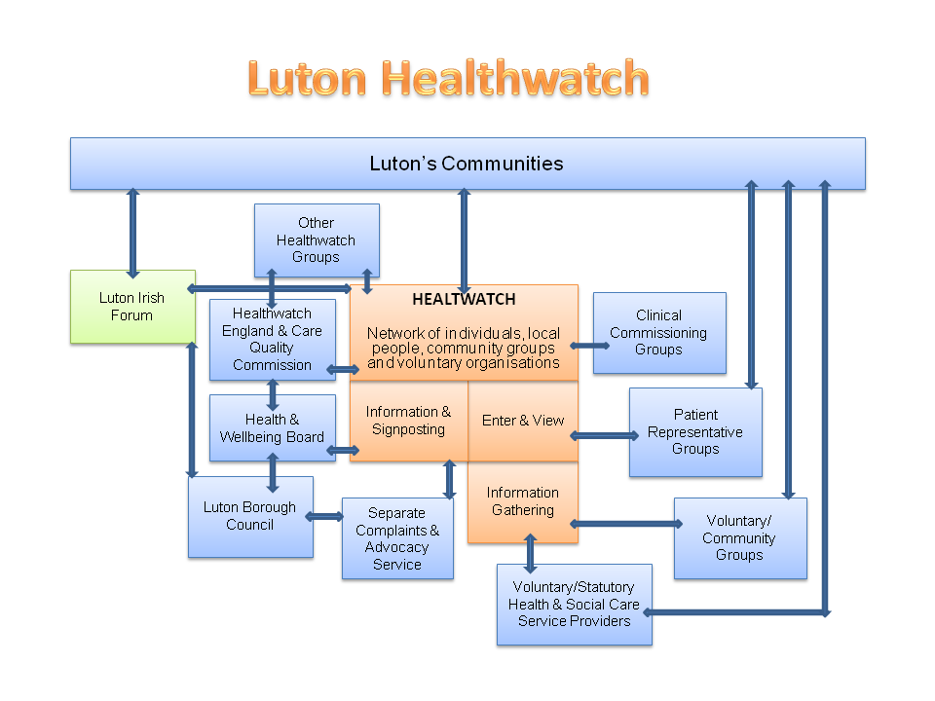
Notes:
Local watchdog group for patients, service users, carers and the general public

Slide 7
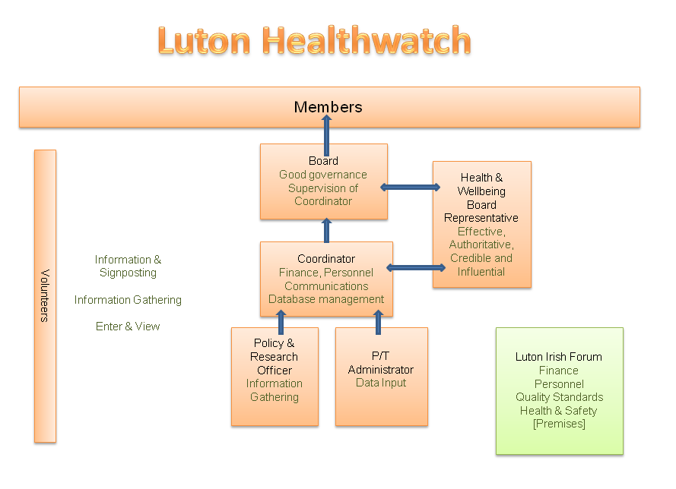

Slide 8
Next steps
Continue to raise profile locally;
Raise profile across Ireland;
Engagement of the 2nd & 3rd generation;
Develop Luton Irish Network.

Slide 9
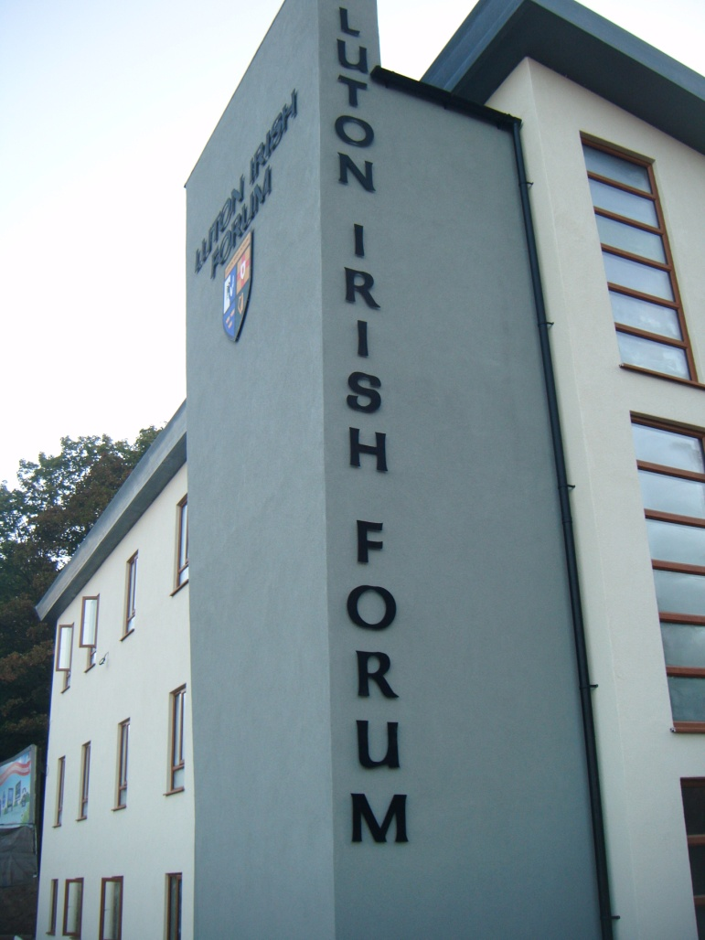



Further information
http://www.healthwatchluton.co.uk/
http://www.lutonirishforum.org/
102 Hitchin Rd, Luton LU2 0ES
Tel: 01582 720447

Slide 10
Questions?

